Slide 1
Structured Query Language
STANLY MOSES.V

Slide 2
OVERVIEW
INTRODUCTION
BASIC SQL
DEFINITION
SQL COMMANDS AND OPERATIONS
TYPES OF CONSTRAINTS IN SQL
DISTINCT COMMANDS
DATA TYPES
CALCULATE FUNCTION
TYPES OF JOINS
QUERIES
TABLE CREATION
SELECT
DISTINCT
ORDER BY
WHERE
DELETE
ALTER
LENGTH
LIKE
TIMESTAMPDIFF
GROUP BY
COUNT
AS-YEAR-AVG
JOINS
SUM
MAX & MIN

Slide 3
INTRODUCTION
MySQL is an open-source relational database management system (RDBMS) known for its performance, scalability, and security.
It uses Structured Query Language (SQL) for data manipulation, making it versatile for various applications. MySQL offers robust data security features, supports cross-platform deployment, and boasts a vibrant user community.
With various storage engines, it caters to different data requirements. Widely used in web development, it's a key component of the LAMP stack.
Linux, Apache, MySQL, and PHP(LAMP)
Its ease of use and active development community make it a popular choice for businesses and developers seeking a reliable, cost-effective database solution.

Slide 4
BASIC SQL
Structured Query Language
Considered one of the major reasons for the commercial success of relational databases
Statements for data definitions, queries, and updates
• Both DDL and DML
• Core specification plus specialized extension
Syntax notes:
• Some interfaces require each statement to end with a semicolon.
• SQL is not case-sensitive

Slide 5
DEFINITION
A database is indeed a medium where data can be stored in an organized and systematic manner. It allows users to create, retrieve, update, and delete data in a structured and efficient manner within a database system.
DBMS:-It is a software which is used to maintain and manage the database. Basic Operations done on a Database:-
1)Create
2)Read
3)Update
4)Delete
(CRUD)
These operations are referred as CRUD operations

Slide 6
SQL commands and operations
SELECT | Retrieve data from tables, specifying columns, filtering, and sorting.
INSERT | Add new records to a table
UPDATE | Modify existing data in a table.
DELETE | Remove records from a table.
CREATE | Create database objects like tables, indexes, and views.
ALTER | Modify the structure of an existing object.
DROP | Delete a database object.
JOIN | Combine data from multiple tables based on related columns.
WHERE | Filter data based on query conditions.
GROUP BY | Group data based on specified columns, often used with aggregate functions.
ORDER BY | Sort query results by one or more columns.

Slide 7
types of constraints in SQL
-
NOT NULL Constraint | Requires a column to have non-null values, ensuring data presence.
UNIQUE Constraint PRIMARY KEY Constraint FOREIGN KEY Constraint DEFAULT Constraint | Enforce data uniqueness, row identification, relationships, and default values.

Slide 8
DISTINCT COMMANDS
ALTER
UPDATE
ALTER TABLE: It is used to modify the structure of an existing table, such as adding, modifying, or dropping columns, constraints, or indexes.
ALTER DATABASE: This command is used to modify the properties and configuration of a database, like changing collation, setting options, or renaming the database.
UPDATE: It is used to modify existing records in a table by changing the values of one or more columns. You can specify a condition to identify the rows to be updated.

Slide 9
DATA TYPES
Numeric Data Types
Date and Time Data Types
String Data Types
Binary Data Types
Spatial Data Types
JSON Data Type
Enumerated Types

Slide 10
Numeric DATA TYPES
Numeric Data Types
Date and Time Data Types
String Data Types
Binary Data Types
Spatial Data Types
JSON Data Type
Enumerated Types
Int
Tinyint, smallint, mediumint, bigint
Float, double
Decimal

Slide 11
Date and Time DATA TYPES
Numeric Data Types
Date and Time Data Types
String Data Types
Binary Data Types
Spatial Data Types
JSON Data Type
Enumerated Types
Date
Time
Datetime
Timestamp
Year

Slide 12
String DATA TYPES
Numeric Data Types
Date and Time Data Types
String Data Types
Binary Data Types
Spatial Data Types
JSON Data Type
Enumerated Types
Char
Varchar
Text
Enum
Set

Slide 13
Binary DATA TYPES
Numeric Data Types
Date and Time Data Types
String Data Types
Binary Data Types
Spatial Data Types
JSON Data Type
Enumerated Types
Binary
VARBINARY
Blob
Bit

Slide 14
Spatial DATA TYPES
Numeric Data Types
Date and Time Data Types
String Data Types
Binary Data Types
Spatial Data Types
JSON Data Type
Enumerated Types
Geometry
Point, LineString, Polygon

Slide 15
JSON DATA TYPES
Numeric Data Types
Date and Time Data Types
String Data Types
Binary Data Types
Spatial Data Types
JSON Data Type
Enumerated Types
Json

Slide 16
Enumerated TYPES
Numeric Data Types
Date and Time Data Types
String Data Types
Binary Data Types
Spatial Data Types
JSON Data Type
Enumerated Types
Enum

Slide 17
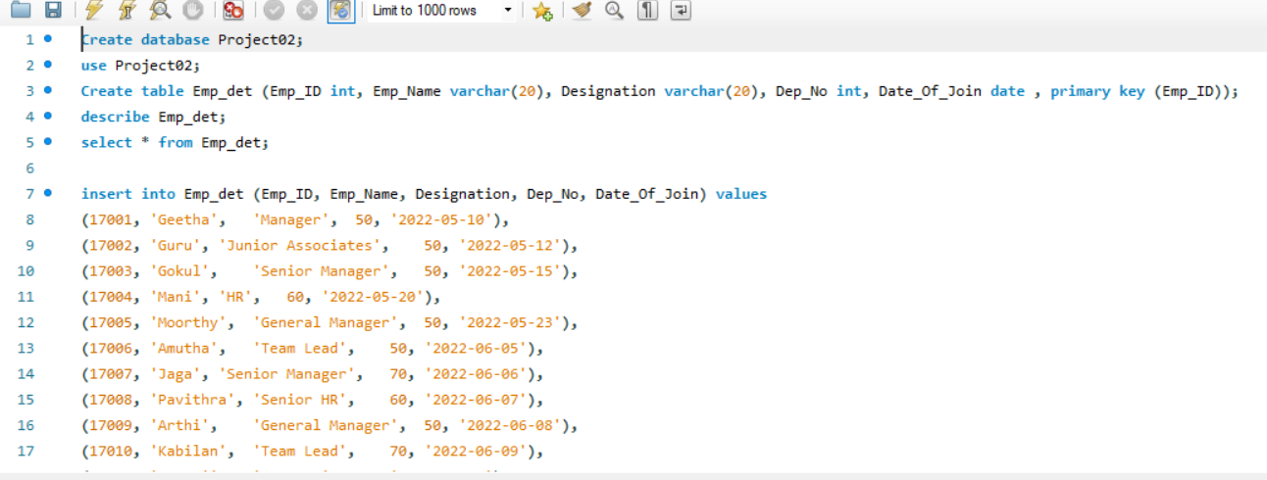
TABLE CREATION

Slide 18
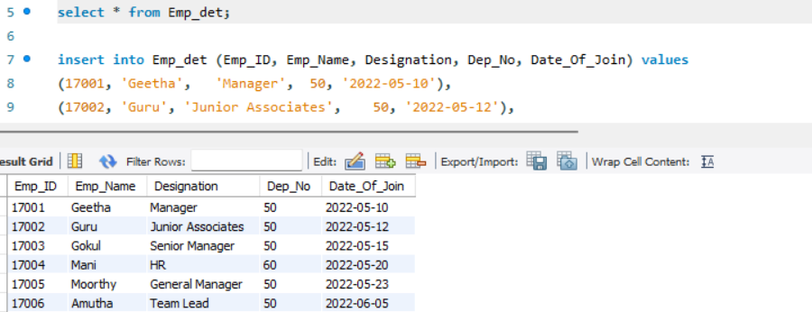
SELECT

Slide 19
INSERT

Slide 20
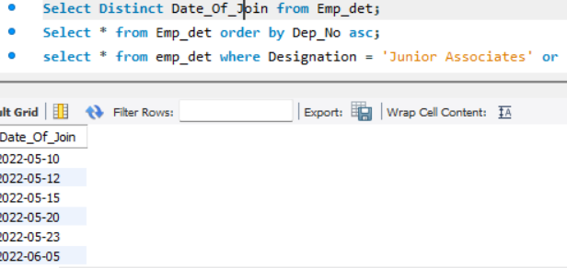
DISTINCT

Slide 21
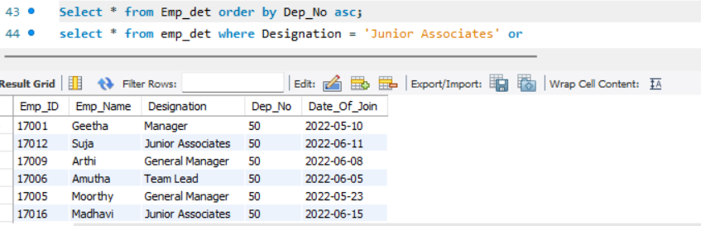
ORDER BY

Slide 22
ORDER BY ASCENDING

Slide 23
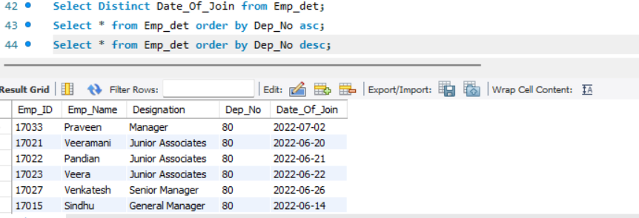
ORDER BY DESCENDING

Slide 24
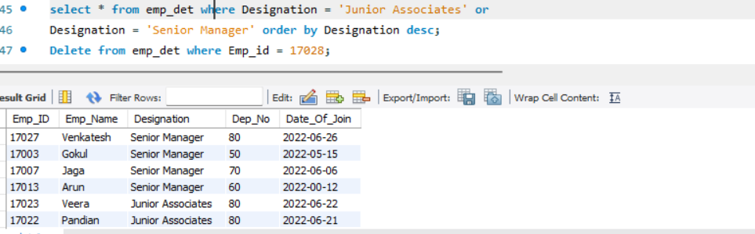
WHERE

Slide 25
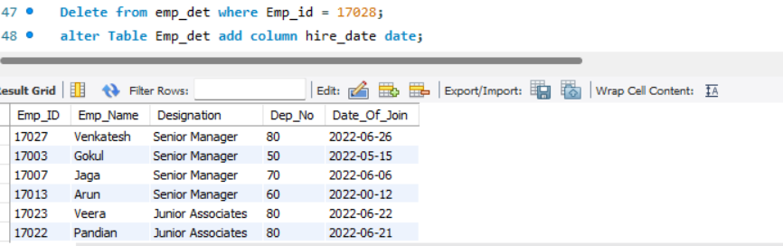
DELETE

Slide 26
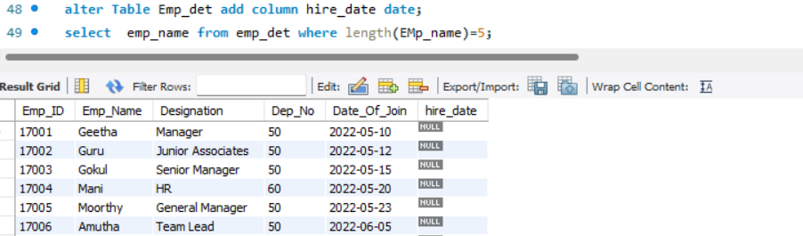
ALTER

Slide 27
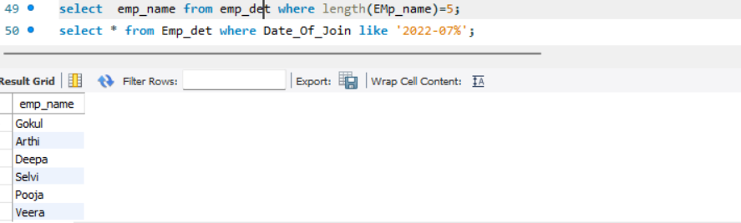
LENGTH

Slide 28
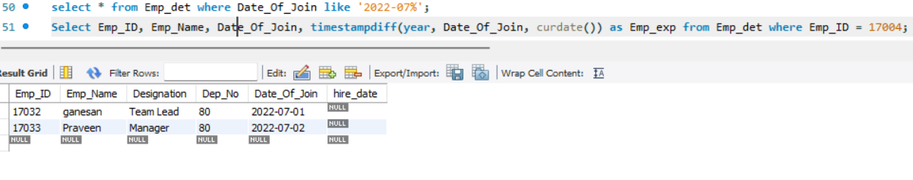
LIKE

Slide 29
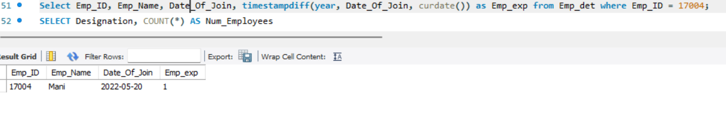
TIMESTAMPDIFF

Slide 30
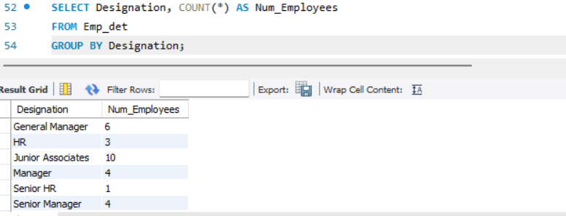
GROUP BY

Slide 31
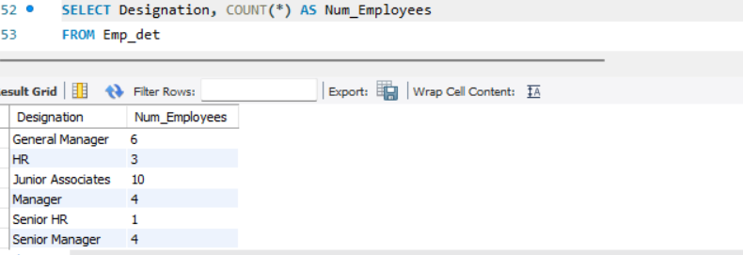
COUNT

Slide 32
CALCULATE FUNCTION
AVERAGE - AVG
MAXIMUM - MAX
MINIMUM - MIN
COUNT - COUNT
SUM - SUM

Slide 33
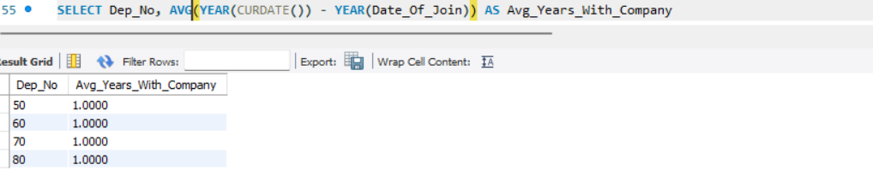
AS-YEAR-AVG

Slide 34
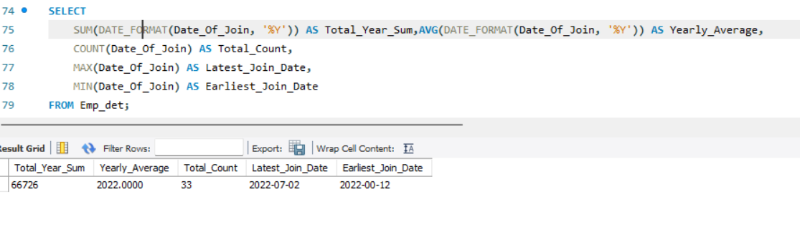
SUM

Slide 35
MAX

Slide 36
MIN

Slide 37
TYPES OF JOINS
INNER JOIN - Returns only the rows with matching values in both tables.
LEFT JOIN - Returns all rows from the left table and the matching rows from the right table
RIGHT JOIN - Returns all rows from the right table and the matching rows from the left table.
FULL JOIN - Returns all rows when there is a match in either the left or the right table. If there are no matches, it returns NULL values for columns from the non-matching table.

Slide 38
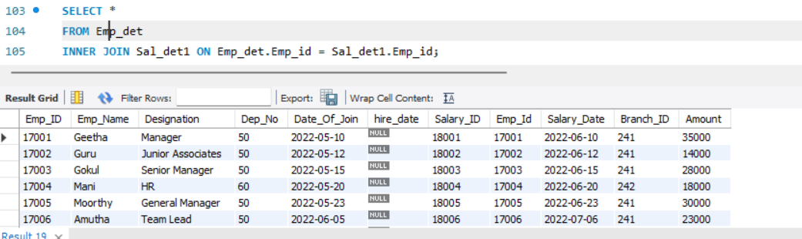
INNER JOIN

Slide 39
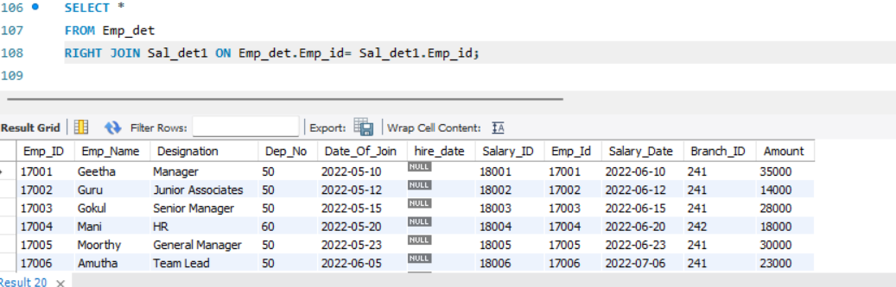
RIGHT JOIN

Slide 40
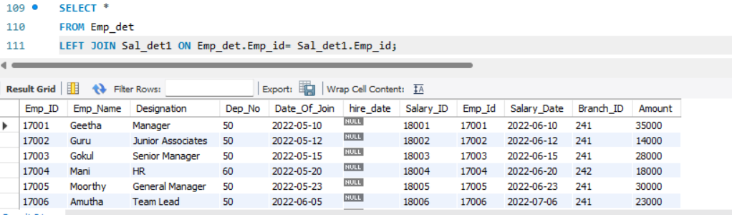
LEFT JOIN

Slide 41
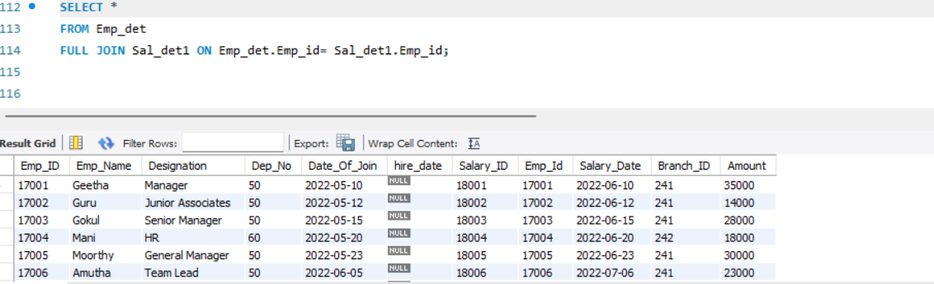
FULL JOIN

Slide 42
SUMMARY
MySQL is an open-source RDBMS known for its performance and ease of use. It uses SQL for data management and is highly structured, utilizing tables with rows and columns. MySQL is freely available, allowing source code modification for customization. SQL commands are used to query and manipulate data within MySQL. It excels in speed and performance, suitable for data-intensive applications. MySQL offers scalability through features like replication and clustering. Security features include user authentication, encryption, and access control. Two editions are available: the free community edition and the commercial enterprise edition. It's compatible with various platforms, including Windows, Linux, and macOS. MySQL supports multiple storage engines like InnoDB and MyISAM and is widely used in web development, owned by Oracle Corporation.

Slide 43
END

